Slide 1
CSE4131: Artificial Intelligence
Class Teacher:
Professor Dr. A K M Akhtar Hossain
Dept. of CSE,
University of Rajshahi

Slide 2
Reference Books:
Dan W. Patterson, Introduction to Artificial Intelligence & Expert Systems, Professor, University of Texas, USA.
2. Elaine Rich, Kevin Knight, S. B Nair, Artificial
Intelligence, 3rd Edition, Tata McGraw Hill, USA.
3. Patrick Henry Winston, Artificial Intelligence , Professor, Massachusetts Institute of Technology, USA.

Slide 3
Artificial Intelligence(AI)
Definition-1:
Artificial Intelligence (AI) is the study of computations that make it possible to perceive, reason and act.
Definition-2:
Artificial Intelligence (AI) is a branch of computer science concerned with the study and creation of computer systems that exhibit some form of intelligence: such as,
systems that learn new concepts and tasks,
systems that can reason and draw useful conclusions about the world around us,
systems that can understand a natural language or perceive and comprehend a visual scene, and
systems that perform other types of feats that require human types of intelligence.

Slide 4
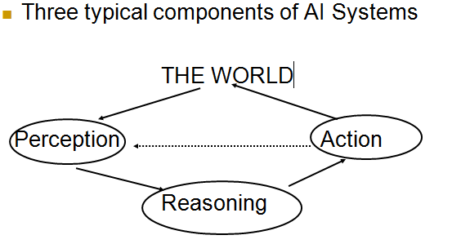
Latest Perception of AI

Slide 5



Example of AI
Red Rose
Colours
White Rose

Slide 6
Artificial:
Produced by human art or effort, rather than originating naturally.
Intelligence:
is the ability to acquire knowledge and use it" [Pigford and Baur]
So AI is defined as:
AI is the study of ideas that enable computers to be intelligent.
AI is the part of computer science concerned with design of computer systems that exhibit human intelligence(From the Concise Oxford Dictionary)

Slide 7
Modern Applications of Artificial Intelligence:
Examples:
Manufacturing robots.
Self-driving cars.
Smart assistants.
Healthcare management.
Automated financial investing.
Virtual travel booking agent.
Social media monitoring.

Slide 8
What is Intelligence?
Intelligence is a property of mind that encompasses many related mental abilities, such as the capabilities to
Reasoning
Learning
Problem Solving
Perception
Linguistic Intelligence

Slide 9
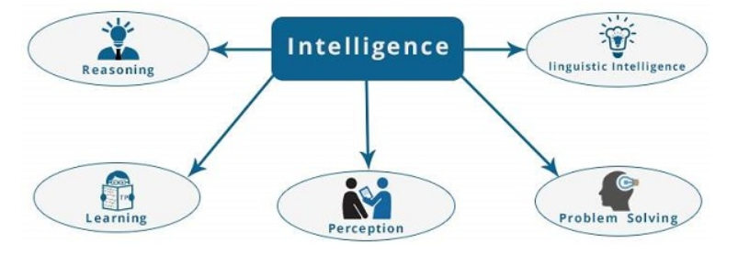
What is Intelligence?

Slide 10
Difference between Human and Machine Intelligence
Humans perceive by patterns whereas the machines perceive by set of rules and data.
Humans store and recall information by patterns, machines do it by searching algorithms.
Humans can figure out the complete object even if some part of it is missing or distorted; whereas the machines cannot do it correctly.

Slide 11
Observations | Human Intelligence | Machine Intelligence
Origin | Human beings are created with the natural ability to think, reason, recall, etc. | Machine intelligence is an innovation which is created by human (scientists).
Speed | Process information slower. | Process information faster.
Decision making | Humans’ decisions may be influenced by subjective elements which are not based on figures alone. | Machine intelligence is highly objective in decision making as it analyzes based on purely gathered data.
Accuracy | May be less accurate. | More accurate.
Energy | Uses 25 watts. | Uses 2 watts.
Adaptation | Can easily adapt to changes. | Cannot adapt to changes well.
Multitasking | Can multitask easily. | Cannot multitask easily.
Self-Awareness | Has self-awareness | Still working towards self-awareness.
Social Interaction | Excellent social skills. | Low social skills.
General Function | Innovation | Optimization

Slide 12
Areas of AI
Areas of AI are:
Artificial Neural Networks
Machine Learning
Deep Learning
Robotics
Knowledge representation
Expert systems
Natural language Processing
Computer vision
Theorem proving
Game playing
Reasoning dealing with uncertainty and decision making

Slide 13
Areas of AI
Learning models, inference techniques
Pattern recognition
Search and matching algorithms
Logic (fuzzy, temporal, modal) in AI
Planning and scheduling
Understanding spoken expressions
Intelligent tutoring systems
Machine translation systems

Slide 14
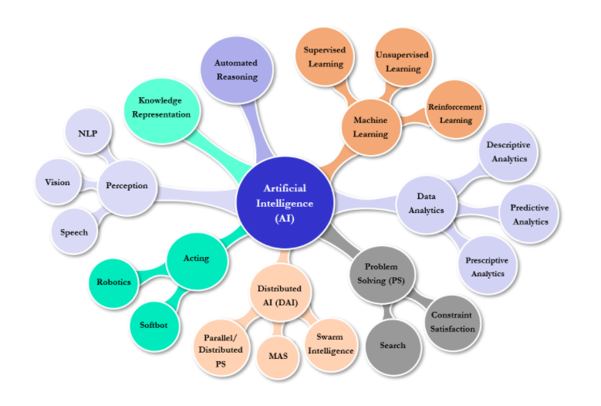

Slide 15
Applications
Business : Financial strategies, give advice
Engineering: check design, offer suggestions to create new product
Manufacturing: Robotics, Assembly, inspection & maintenance, military weapons, satellites, Space rocket, Sky rockets, Missiles, Ballistic missiles
Mining: used when conditions are dangerous
Hospital : monitoring, diagnosing & prescribing
Education : In teaching and research
Household : AI based Devices for cooking, washing & storing, etc.
Farming : prune trees & selectively harvest mixed crops, biotechnology, genetics engineering.

Slide 16
History of AI
1943: early beginnings
McCulloch & Pitts: Boolean circuit model of brain
1950: Turing
Turing's "Computing Machinery and Intelligence“
1956: birth of AI
Dartmouth meeting: "Artificial Intelligence“ name adopted
1950s: initial promise
Early AI programs, including
Samuel's checkers program
Newell & Simon's Logic Theorist
1955-65: “great enthusiasm”
Newell and Simon: GPS, general problem solver
Gelertner: Geometry Theorem Prover
McCarthy: invention of LISP

Slide 17
History of AI
1966—73: Reality dawns
Realization that many AI problems are intractable
Limitations of existing neural network methods identified
Neural network research almost disappears
1969—85: Adding domain knowledge
Development of knowledge-based systems
Success of rule-based expert systems,
E.g., DENDRAL, MYCIN
But were brittle and did not scale well in practice
1986-- Rise of machine learning
Neural networks return to popularity
Major advances in machine learning algorithms and applications
1990-- Role of uncertainty
Bayesian networks as a knowledge representation framework
1995– 2021 AI as Science
Integration of learning, reasoning, knowledge representation, Deeping learning
AI methods used in vision, language, data mining, Robotics etc

Slide 18
What is knowledge?
Knowledge can be defined as the body of facts and principles accumulated by human-kind or the fact, or state of knowing.
Knowledge should not be confused with data.
In biological organisms, knowledge is likely stored as complex structures of interconnected neurons.
In Computer Science, knowledge is also stored as complex structures, but in the form of collections of magnetic spots and voltage states.

Slide 19
Five types of knowledge
Meta Knowledge – It’s a knowledge about knowledge and how to gain them
Heuristic – Knowledge – Representing knowledge of some expert in a field or subject.
Procedural Knowledge – Gives information/ knowledge about how to achieve something.
Declarative Knowledge – Its about statements that describe a particular object and its attributes , including some behavior in relation with it.
Structural Knowledge – Describes what relationship exists between concepts/ objects.

Slide 20
Types of Knowledge
Procedural knowledge is compiled knowledge related to the performance of some task.
Example: To solve the algebraic equations.
Declarative knowledge is the passive knowledge expressed as statements of facts about the world.
Example: Personnel data in a database.

Slide 21
Types of Knowledge
Heuristic knowledge is a special type of knowledge, which is used by human to solve complex problems.
Examples: Good judgments, tricks, rules of thumb.

Slide 22
Meta Knowledge
Meta Knowledge is knowledge about knowledge.
The term is used to describe things such as tags, models and taxonomies that describe knowledge.
Several academic areas including bibliography, the study of books, the philosophy of knowledge, are also considered meta-knowledge.

Slide 23
Structural knowledge
According to Jonassen (2000), structural knowledge, which connects declarative and procedural knowledge.
Structural Knowledge – It is a basic problem-solving knowledge that describes the relationship between concepts and objects.
Structural knowledge is knowledge of how the ideas within a domain are integrated and interrelated.
Example: family relations, social relations, logical relations, administrative organizations, military hierarchies, etc.

Slide 24
Cycle of Knowledge Representation in AI
Artificial Intelligent Systems usually consist of various components to display their intelligent behavior.
Some of these components include:
Perception
Learning
Knowledge Representation & Reasoning
Planning
Execution

Slide 25
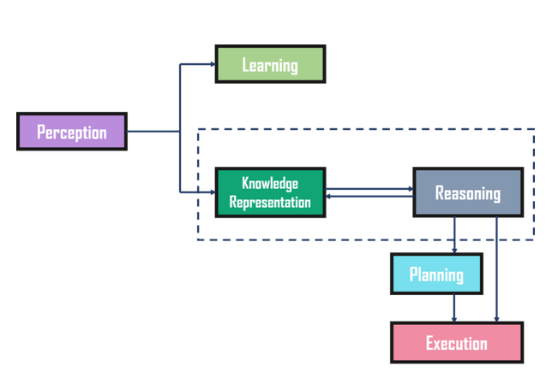
Cycle of Knowledge Representation in AI

Slide 26
Some Terminology on Knowledge
Belief: We define belief as essentially any meaningful and coherent expression that can be represented. Thus a belief may be true or false.
Hypothesis: We define a hypothesis as a justified belief that is not known to be true.
Thus , a hypothesis is a belief which is backed up with some supporting evidence, but it may still be false.
Finally, we define knowledge as true justified belief (Dan W. Petterson).

Slide 27
Academic Disciplines required to understand AI.
Philosophy Logic, methods of reasoning, mind as physical system, foundations of learning, language, rationality.
Mathematics/ Formal representation and proof, algorithms, Statistics computation, decision theory, probability.
Economics utility, costing
Neuroscience neurons as information processing units.
Psychology/ how do people behave, perceive, process Cognitive Science information, represent knowledge.
Computer building faster computers engineering
Control theory design systems that maximize an objective function over time
Linguistics knowledge representation, grammar, programming
languages

Slide 28
END TODAY
THANKS

